Slide 1
Maxon motor
EOPS2 motor driver
STM32
TJA1050
CANopen
SDO
24V battery
CAN bus analyzer

Slide 2
Software used
EPOS studio
Mbed online complier
CAN bus analyze software

Slide 3
First step:
Set up motor with EPOS studio

Slide 4
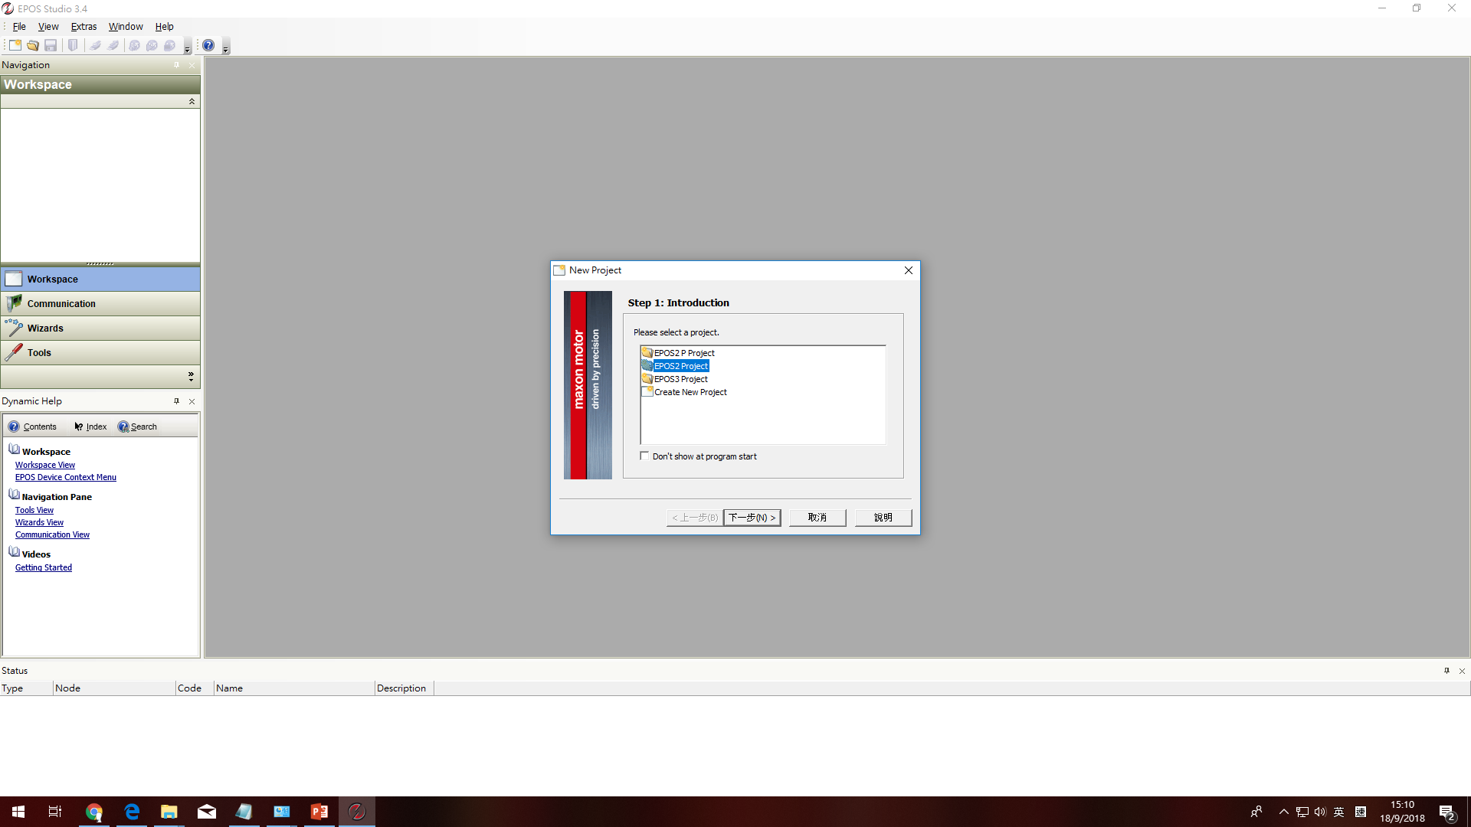

Slide 5
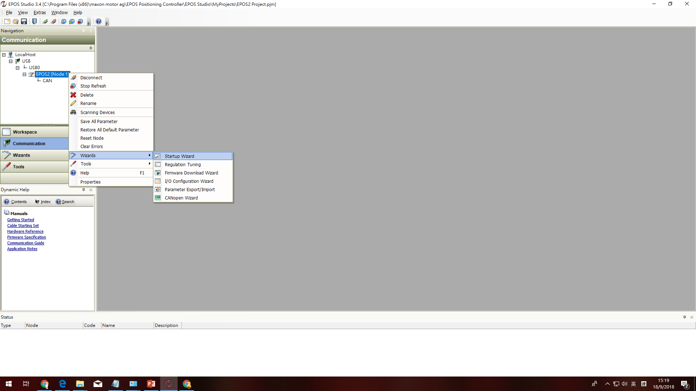

Slide 6
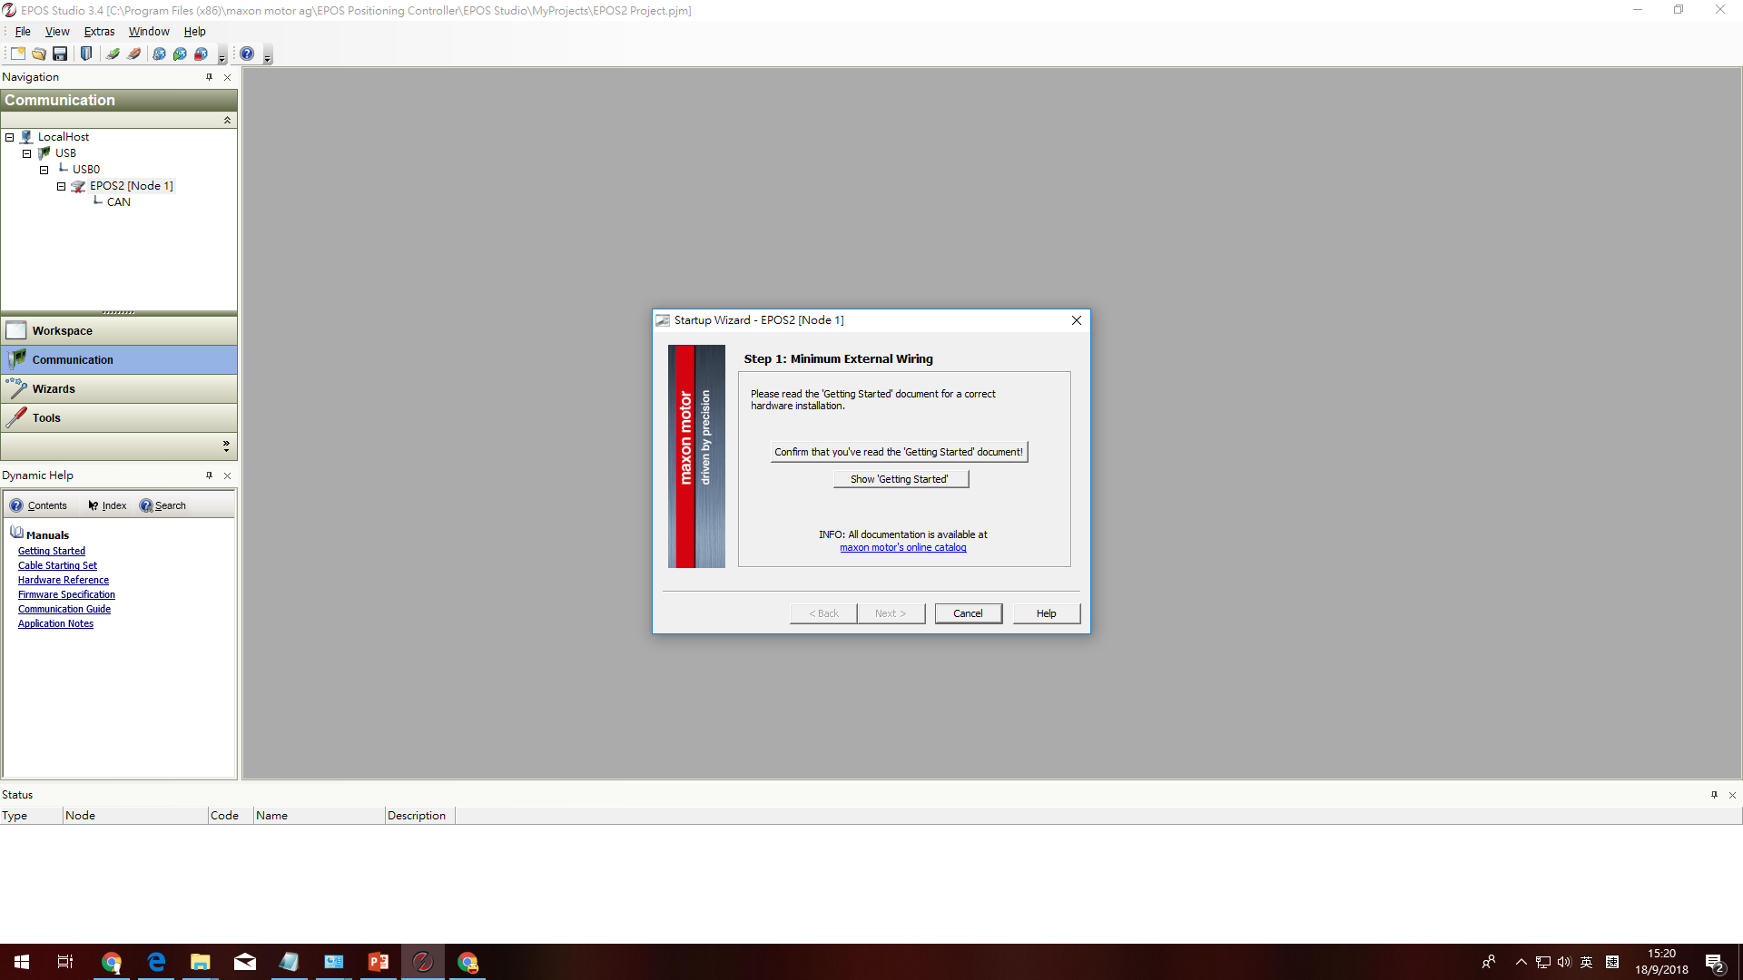

Slide 7
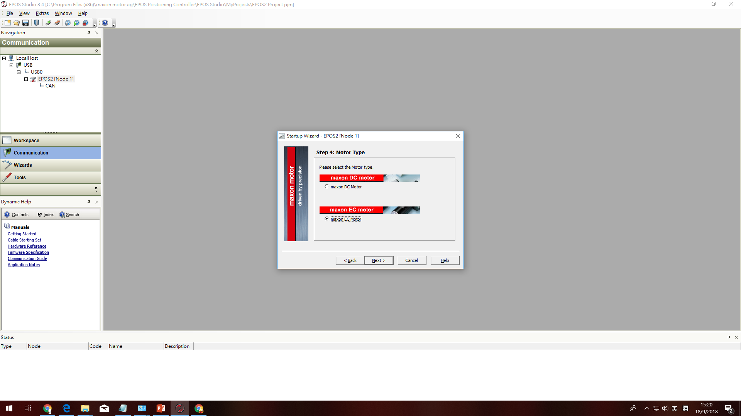

Slide 8
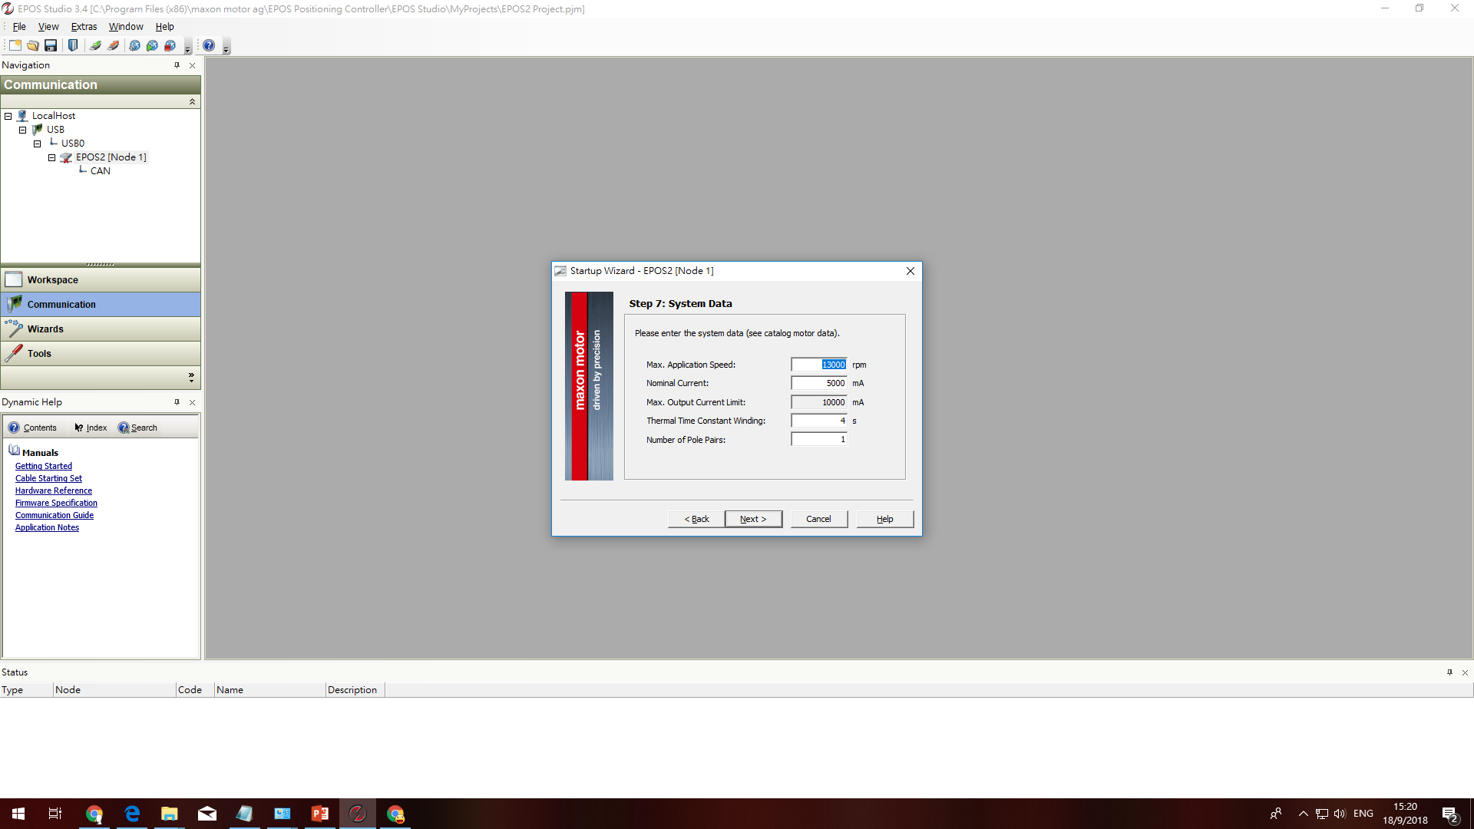

Slide 9
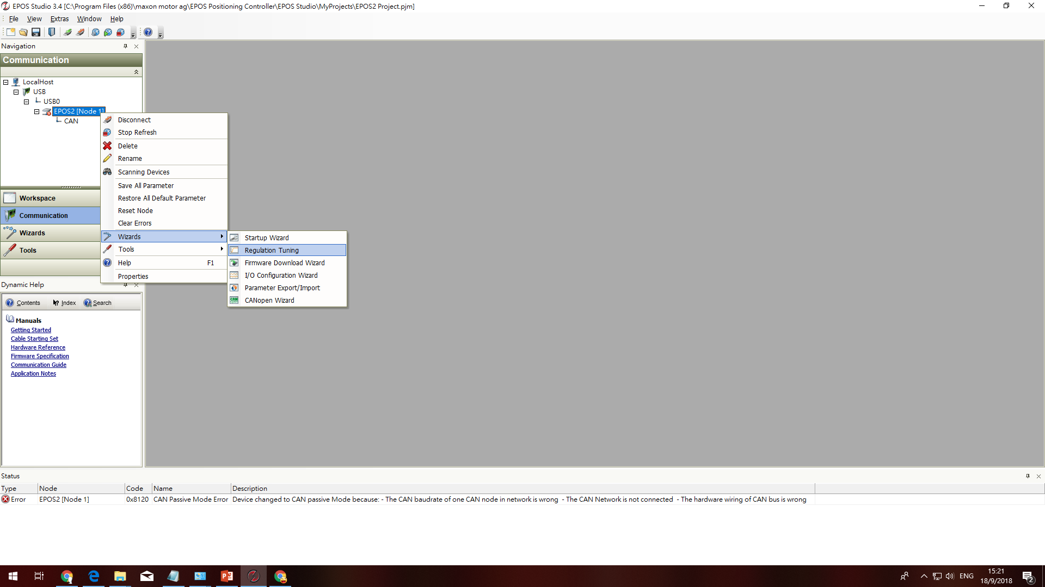

Slide 10
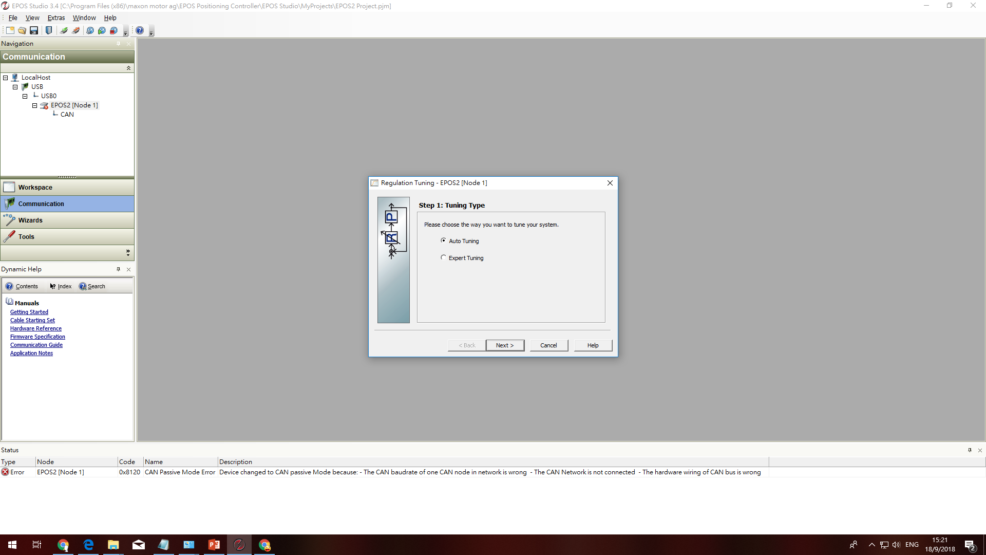

Slide 11
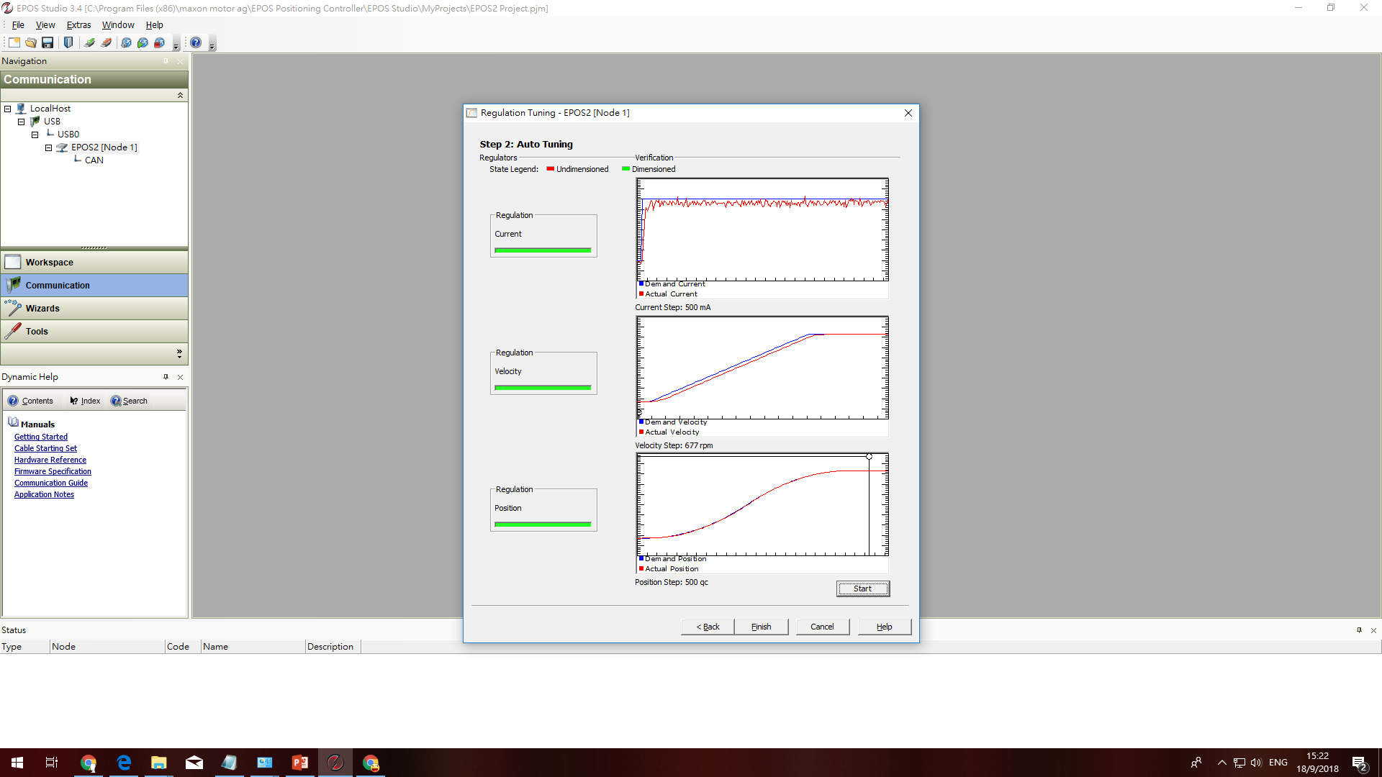

Slide 12
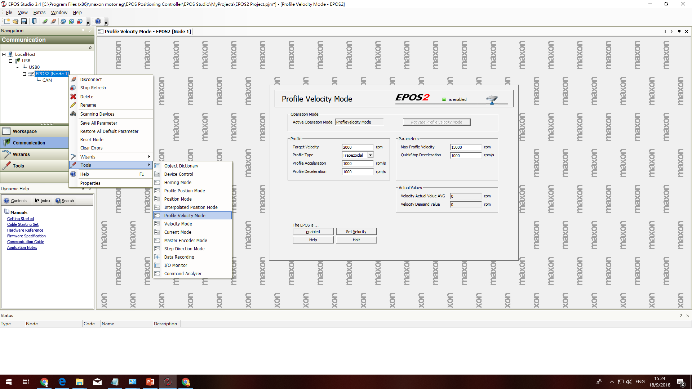

Slide 13
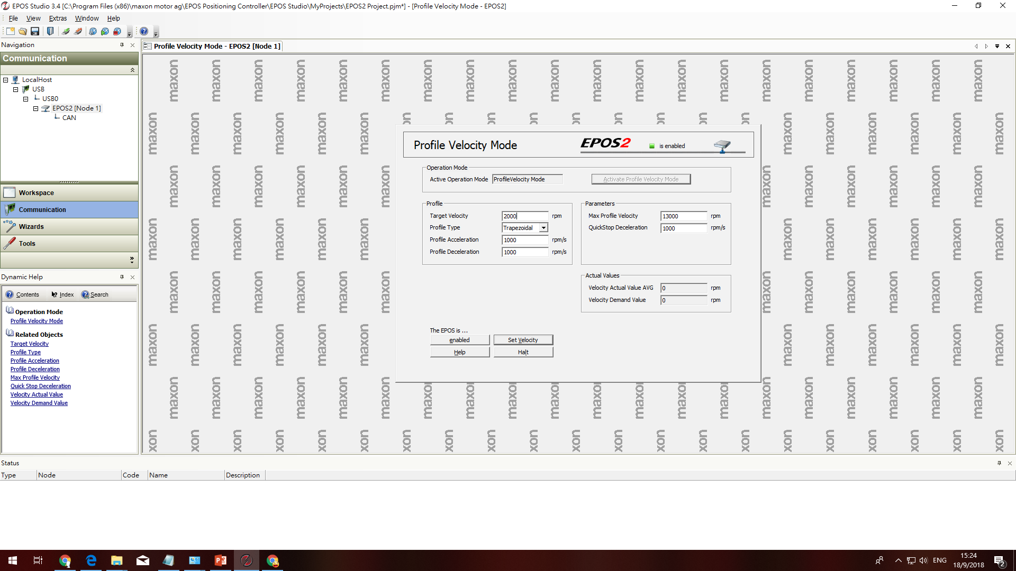

Slide 14
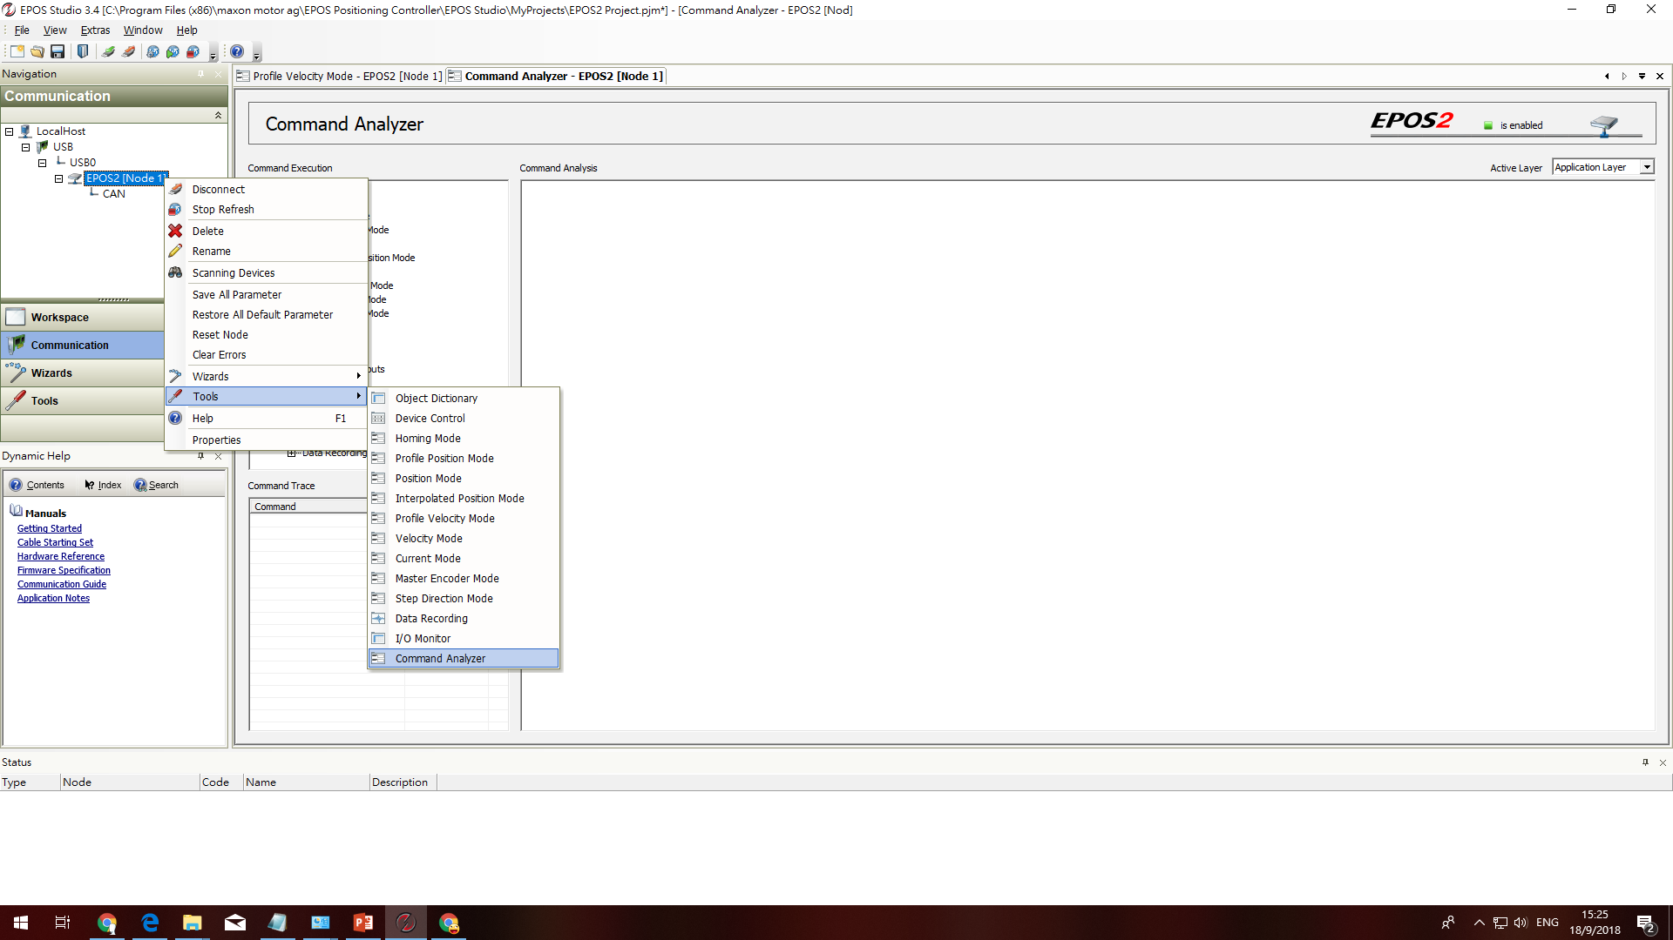

Slide 15
Next step:
EPOS 2
Positioning Controllers
Application Notes

Slide 16
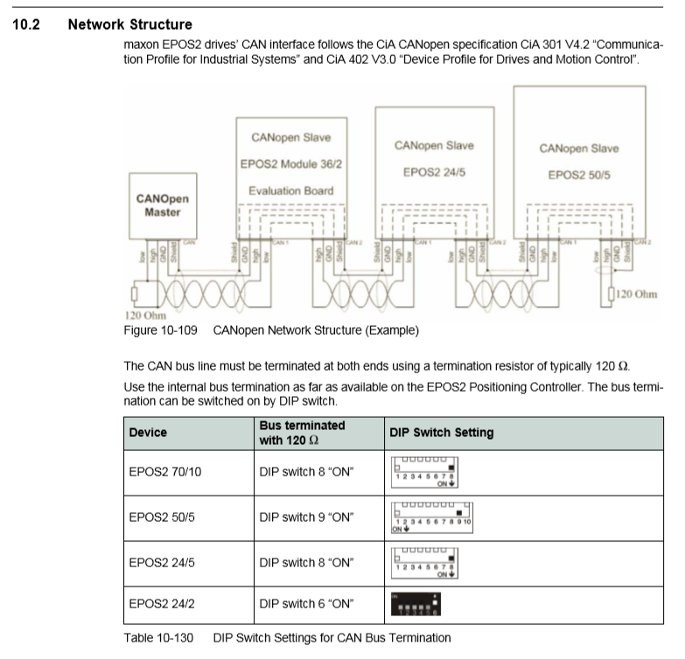
In my case
STM32
EPOS2 70/10
EPOS2 70/10
EPOS2 70/10

Slide 17
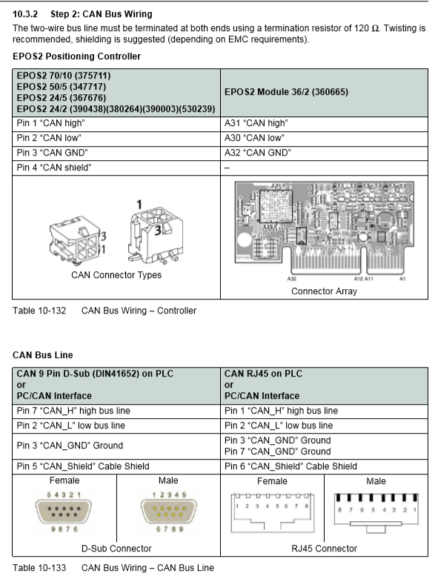

Slide 18
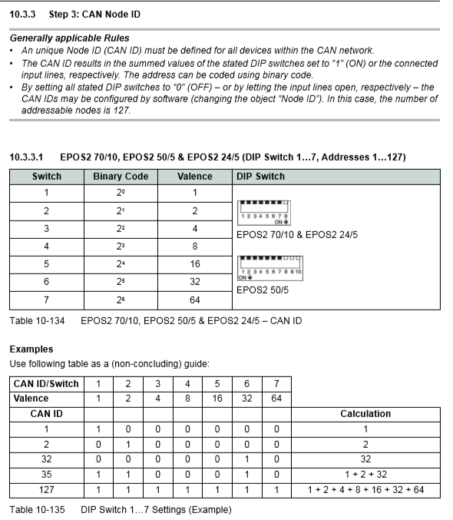

Slide 19
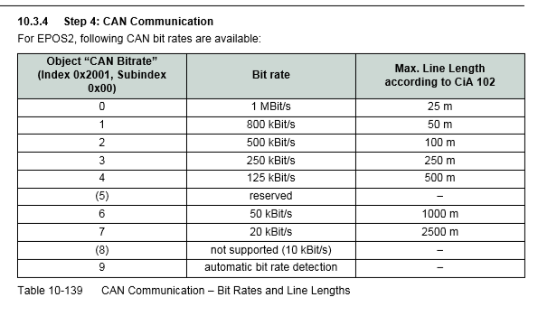

Slide 20
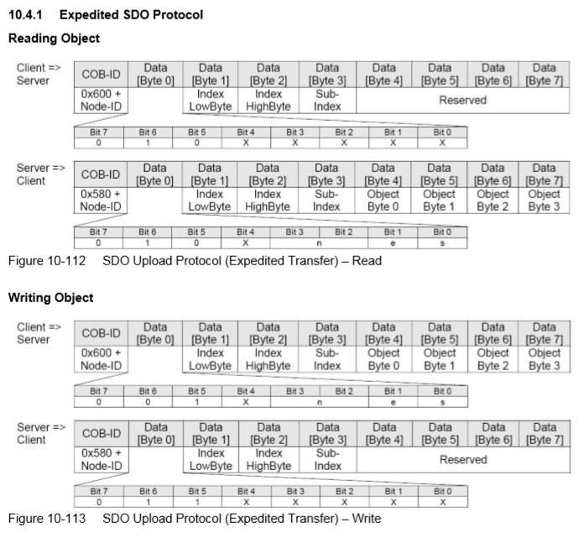
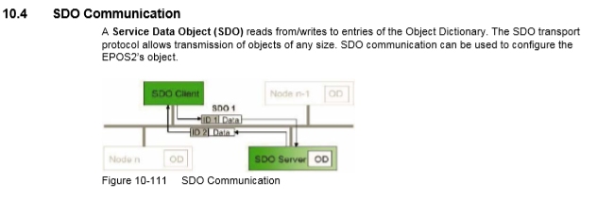
SDO communication
Client : STM32
Server: EPOS2
How many byte you don’t need
Bit 3 | Bit 2 | XX byte
0 | 0 | 0
0 | 1 | 1
1 | 0 | 2
1 | 1 | 3

Slide 21
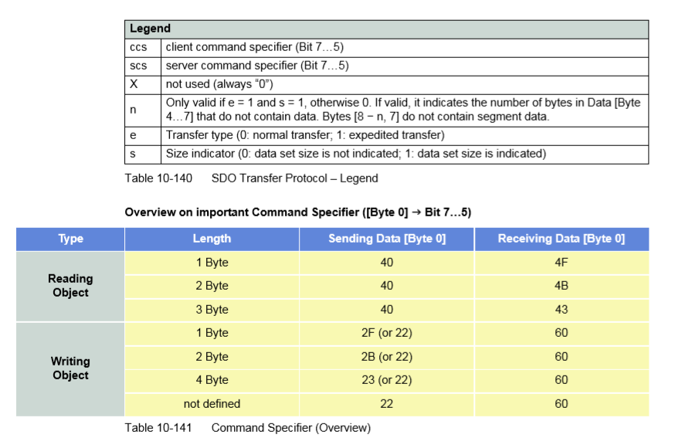

Slide 22
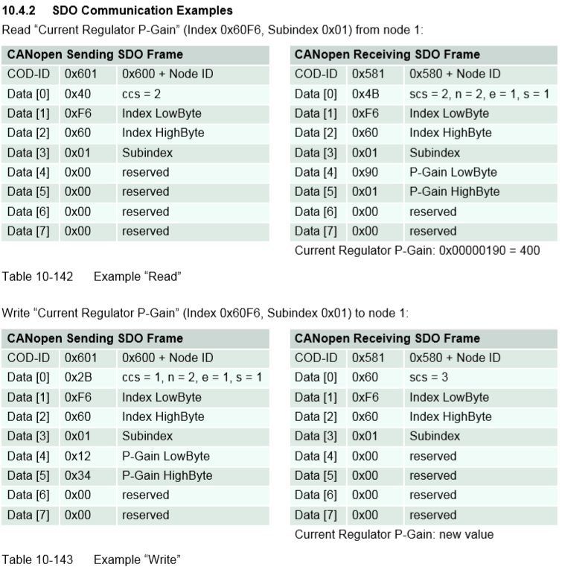

Slide 23
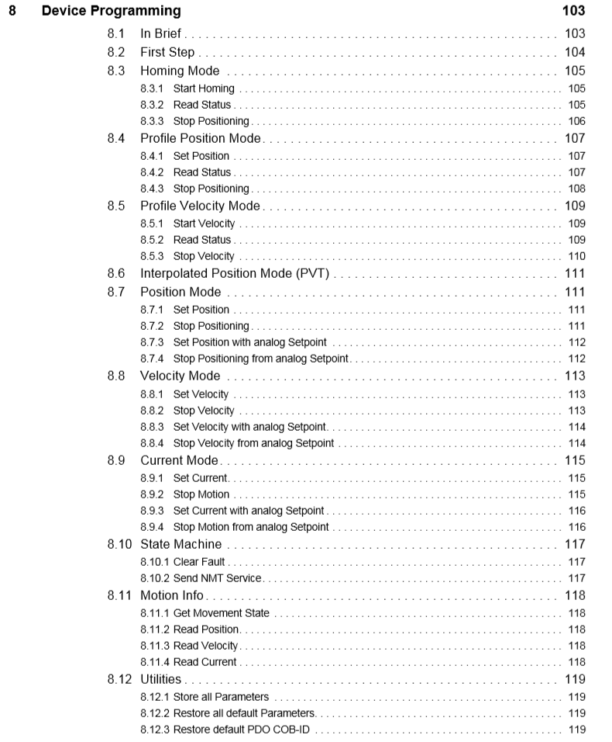

Slide 24
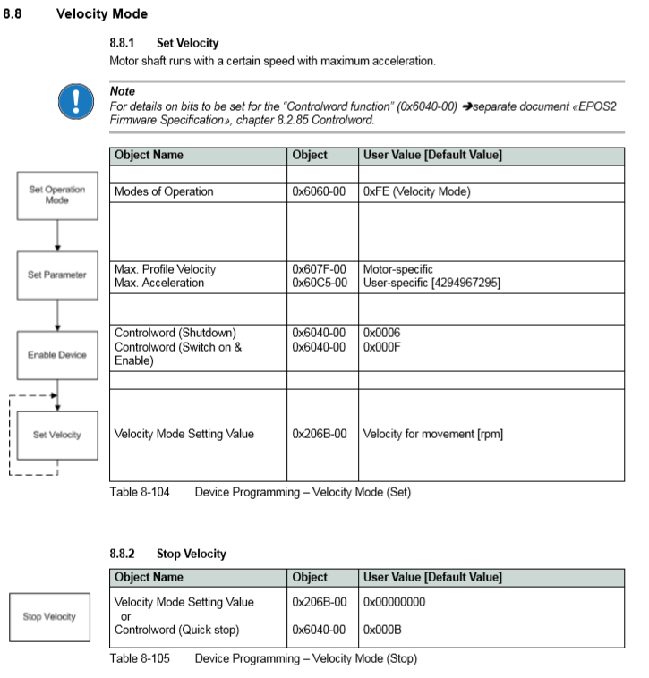
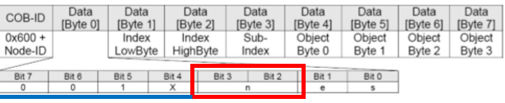
index
Sub-index
0 | 0 | 1 | 0 | 1 | 1 | 1 | 1
3
0 | 0 | 1 | 0 | 1 | 0 | 1 | 1
2

Slide 25
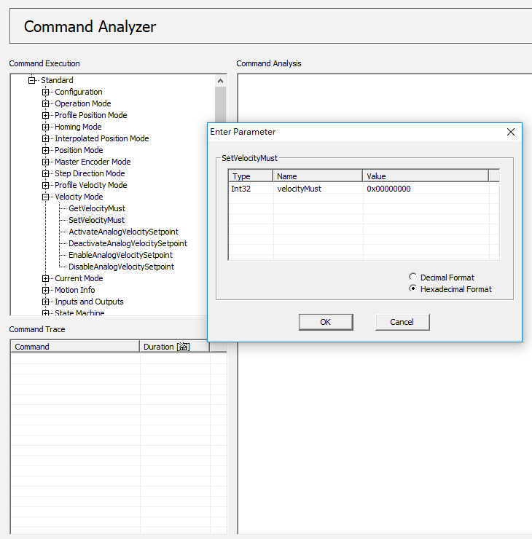

Slide 26
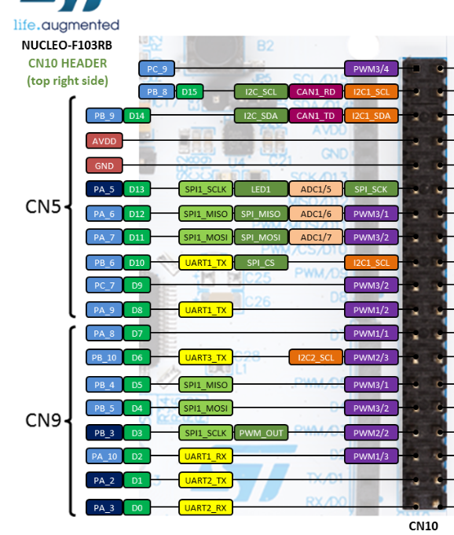
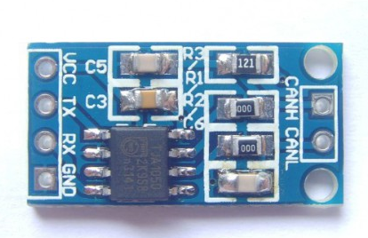
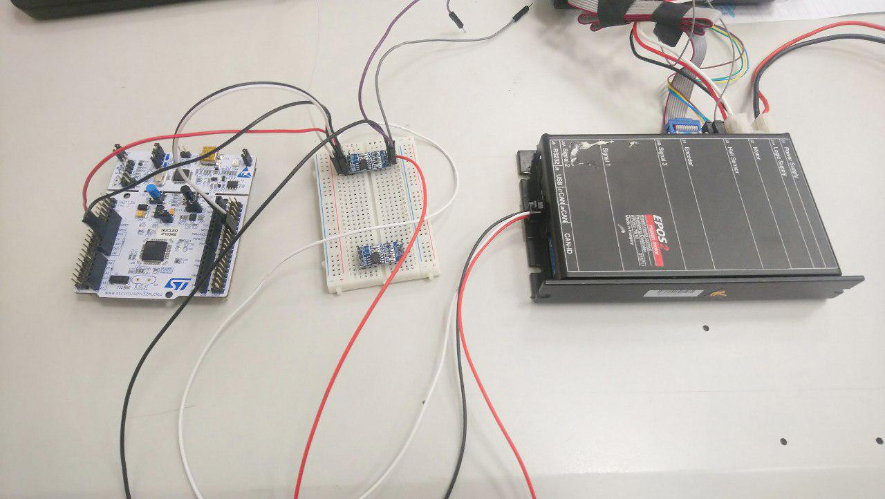
STM32 TJA1050
TD->Tx
RD->Rx

Slide 27
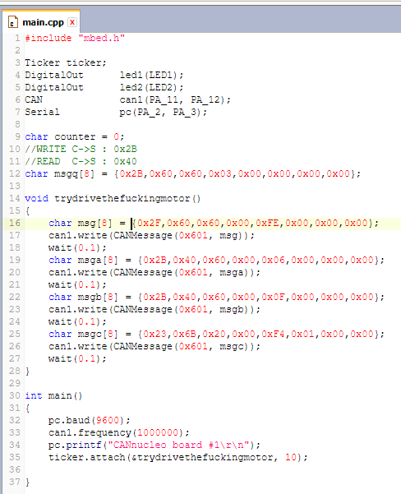
https://www.facebook.com/williamlun6/videos/10210677126959081/

